Slide 1
Financial Sustainability Workshop
2013
Day 1
Based on guidance from Mango course FM2 Financial Sustainability Essentials – How to Build a Financing Strategy

Slide 2
What is Financial Sustainability?
Financial sustainability is part of organisational sustainability. It has to do with the ongoing ability of the organisation to generate enough resources to work towards its vision and mission.
Financing
the mission
S
Managing risk
Organisational regeneration
S
Impact
Resources
S = Financial Sustainability

Slide 3
Indicators of Financial Sustainability
Paths to success include:
Developing and maintaining strong stakeholder relationships, including beneficiaries, staff and donors
Obtaining a range of types of funding, including unrestricted funds
Building financial reserves
Assessing and managing risks
Strategically managing and financing overhead costs

Slide 4
Why is a Financial Strategy Important?
Creating a viable and sustainable organisation
Reducing dependency
Expansion and development
Building up support in the local community

Slide 5
Developing a Financial Strategy
There are four basic questions you must answer, in order to have a Financial Strategy:
Where are we now?
Where do we want to be?
How do we get there?
Policies (or What are our rules to get there?)

Slide 6
Developing a Financial Strategy
1. Where are we now?
Where the organisation is at the start of the strategy. It includes an assessment of the key risks facing the NGO and the opportunities and resources it has available.
It usually entails analysis of:
Current stakeholders
The organisation’s Strenghts, Weaknesses, Opportunities & Constraints (SWOC)
Past and current donor dependency
Level of general reserves
Past and current funding mix

Slide 7
Developing a Financial Strategy
2. Where do we want to be?
This section summarises key financial targets for three to five years’ time, and is informed by the risks and opportunities identified in the first section.
It will include as a minimum:
The desired funding mix – the balance and sources of restricted and unrestricted funds.
Donor dependency – linked to the funding mix, this is the realistic and appropriate level of funding to accept from donor agencies (expressed as a percentage of overall income).
Level of general reserves – usually expressed as the number of days that the organisation could continue without external funding.

Slide 8
Developing a Financial Strategy
3. How do we get there?
This is the ‘meat’ of the financing strategy. It describes what actions you will take each year to finance the strategic plan and achieve the financial targets identified in the second section.
This might include sections on how to:
Increase the mix and level of unrestricted funds
Finance core costs
Build up reserves
Replace and maintain fixed assets
Apply funds to achieve maximum benefit
Notes:
For example, actions to increase the percentage of unrestricted income might include:
- increasing or introducing fees for users of services to recover some or all of the costs of providing the service;
- introducing income-generating activities;
- making use of under-utilised resources (eg renting out office space, vehicles);
- increasing the priority given to fundraising for unrestricted funds.

Slide 9
Developing a Financial Strategy
4. Key Policies
Once you have established your goals and how to achieve them, you must define the conditions or ‘rules’ that guide your organisation’s activities, for both internal and external knowledge.
The most common policies for NGOs are:
Reserves policy – what level of reserves you aim to build up, and how surpluses will be handled.
Core costs policy – what method will be used to recover programme support costs from projects and funders.
Pricing and cost recovery policy – where charges are to be made to service users, this will explain the basis and formula used for the charging, and the pricing structure.
Ethical policy – this will explain who the NGO will or will not accept funds from and what funds may or may not be used for.
Notes:
Once you have established your goals and how to achieve them, you must define the conditions or ‘rules’ that guide your organisation’s activities, for both internal and external knowledge
Reserves policy – what level of reserves you aim to build up, and how surpluses will be handled.
Core costs policy – what method will be used to recover programme support costs from projects and funders. It will also clarify the policy on subsidising ‘poorer’ projects and how that will be decided and managed.
Pricing and cost recovery policy – where charges are to be made to service users, this will explain the basis and formula used for the charging, and the pricing structure.
Ethical policy – this will explain who the NGO will or will not accept funds from and what funds may or may not be used for. This will be particularly relevant to NGOs involved in advocacy work.

Slide 10
Stakeholder Analysis
Stakeholders are those who:
Are affected by or can affect your work
May place demands on you
Have an interest in your work
Stakeholders might be:
Individuals, groups or organisations - including government departments, private sector, donors, NGOs, local communities, staff and so on…
Analysis useful to help you to:
Clarify the content and scope of stakeholder influence
Highlight and tensions / contradictions in demands being made
Clarify scope of influence

Slide 11
Activity: Basic Stakeholder Analysis
Spend 5 minutes writing down all the stakeholders you can think of that can influence, are affected by, or have an interest in your organisation’s work.

Slide 12
Activity: Basic Stakeholder Analysis
Place each stakeholder in the most suitable quadrant, taking into account:
 | Keep Satisfied | Manage Closely
 | Monitor | Keep Informed
  Their interest in the organisation
  Their expectations from the relationship
  Their potential contribution to
  / influence on the organisation
Influence
Interest
Notes:
Each quadrant may represent a priority/relationship
Low Influence/Low Interest – Monitor
Low Influence/High Interest – Keep Informed
High Influence/Low Interest – Keep Satisfied
High Influence/High Interest – Manage closely

Slide 13
[Org]’s Stakeholder Analysis
Influence
Interest

Slide 14
Activity: [Org]’s Stakeholder Action Plan
In groups, fill in the Stakeholder Action Plan Table, describing how you should manage your relationship with each main stakeholder
Stakeholder Action Plan
Stakeholder | Frequency of contact | Interest | Influence | Expectation | Action plan
Ministry of Environment & Natural Resources | Quarterly | Our organisation allows them to achieve their quota for partnerships with NGOs | Solar stove supplies. FX variations, Finnish govt. aid policy | Add their logo to all vehicles and merchandise; Quarterly technical and financial reports | Invite to visit to see work; send examples of recent successes

Slide 15
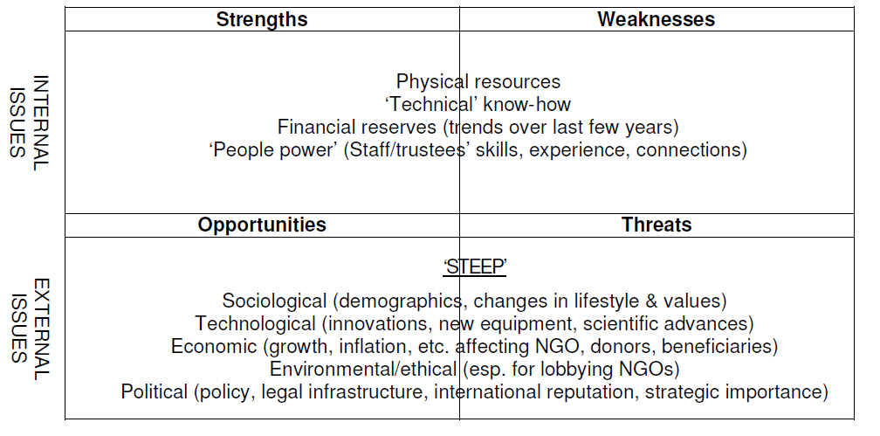
SWOC Analysis
Constraints

Slide 16
Activity: SWOC Analysis
In groups, write down your Strengths^{(internal)}, Weaknesses^{(internal),} Opportunities^{(external)} and Constraints^{(external)} – one per post-it
As one group, organise all the post-its by topic, making note of potential overlaps
Individually, vote for your top 3 priorities in each category

Slide 17
Activity: SWOC Analysis
Looking at the SWOC and Stakeholder Analysis, extract:
  Potential risks to [Org]’s Finance Sustainability
    E.g. – The only person who could write proposals in English leaves the organisation, when most donors are from the US, UK or Australia
  Potential opportunities that [Org] could explore in order to improve its Financial Sustainability
    E.g. 1 – The local University starts a work experience placement system, where students get credits by spending 6 months with an organisation, developing specific skills
    E.g. 2 – The local Government is interested in partnering with NGO, to demonstrate interest in environmental issues

Slide 18
Risk Mapping
Having identified key risks using the SWOC analysis technique, the next stage is to assess their relative importance so that a risk strategy can be developed.
A. Likelihood of the risk occurring:
B. Impact of the risk should it happen:
Points | Likelihood | Notes
3 | Likely | Expected to happen, to a more than even chance of happening
2 | Possible | Quite possible that it will occur, to an even chance of it happening
1 | Remote | Just possible it might happen but very surprising, to extremely unlikely
Points | Impact | Notes
3 | Critical | Impact can make a material or significant difference
2 | Moderate | Impact can make a difference
1 | Manageable | There is an impact but it is deemed to be manageable
 | Remote (1) | Possible (2) | Likely (3)
Critical (3) | 3 | 6 | 9
Moderate (2) | 2 | 4 | 6
Manageable (1) | 1 | 2 | 3

Slide 19
Risk Mapping
Example Scenario
NGO X receives 90% of its income from Donor ABC, whose funding cycle with partners works on a 3 to 5 year basis. As year 3 is approaching, NGO X identifies the risk of the lack of continuity of funding from their donor. The likelihood of failing to get an extension of funding for two more years is assessed.
Assessment:
A. Likelihood of a failed extension-funding bid is assessed as REMOTE because the NGO has developed a very good working relationship with the donor. 1 point awarded.
B. Impact: if extension funding is not received this would be CRITICAL for the NGO as it has no other sources of funding. 3 points awarded.
Result: 1 x 3 = 3 points. This risk would therefore appear in the top left box on the risk map matrix.

Slide 20
Risk Mapping
Ok, but now imagine you didn’t take any action and it’s year 4…
Assessment:
A. Likelihood of a failed extension-funding bid is assessed as LIKELY because the donor only gives grants up to 5 years. 3 points awarded.
B. Impact: if extension funding is not received this would be CRITICAL for the NGO as it has no other sources of funding. 3 points awarded.
Result: 3 x 3 = 9 points. This risk would therefore appear in the top left box on the risk map matrix.

Slide 21

Thank you!

Slide 22
Financial Sustainability Workshop
2013
Day 2

Slide 23
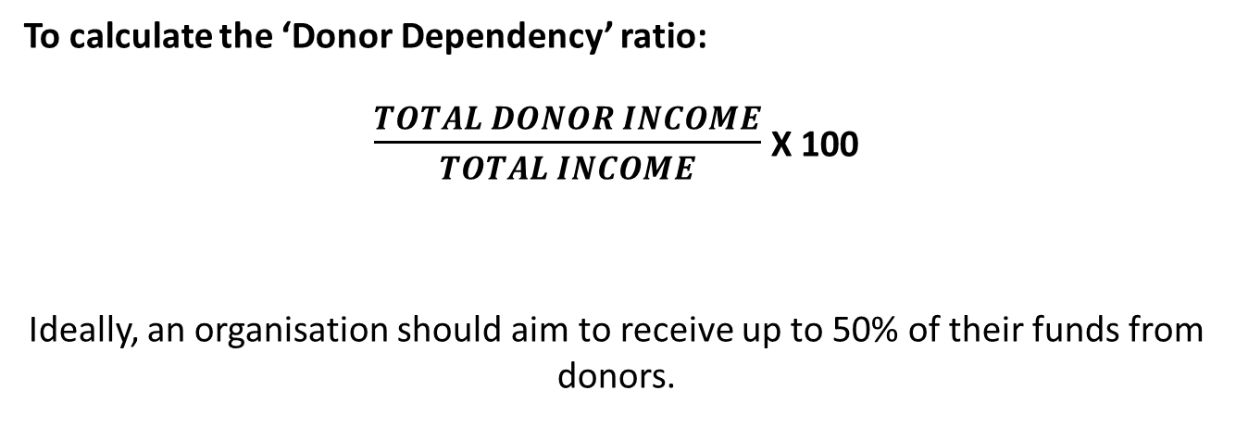
Are you donor dependent?
To calculate the ‘Donor Dependency’ ratio:
$\frac{TOTAL DONOR INCOME}{TOTAL INCOME}$ X 100
Ideally, an organisation should aim to receive up to 50% of their funds from donors.

Slide 24
Are you donor dependent?
 |  |  |  | 2009 | 2010 | 2011 | 2012
Merchandise |  |  |  |  | 1,500 | 5,000 | 2,000
Corporate contracts | A |  |  | 1,000 | 1,500 |  | 1,000
 | B |  |  | 1,000 |  | 1,250 | 2,000
Grants from foundation and contracts from NGOs | AA |  |  | 1,000 | 1,500 | 1,250 | 2,000
 | BB |  |  | 1,000 | 1,500 | 1,250 | 2,000
 | CC |  |  | 1,000 |  | 1,250 | 2,000
 | DD |  |  | 1,000 |  |  | 2,000
 | EE |  |  | 1,000 | 1,500 | 1,250 | 1,000
 | FF |  |  | 1,000 |  |  | 2,000
 | GG |  |  | 1,000 | 1,500 | 1,250 | 2,000
Grand Total |  |  |  | 9,000 | 9,000 | 12,500 | 18,000

Slide 25
Are you donor dependent?
 |  |  |  | 2009 | 2010 | 2011 | 2012
Merchandise |  |  |  | 100% | 83% | 60% | 88%
Corporate contracts | A
 | B
Grants from foundation and contracts from NGOs | AA
 | BB
 | CC
 | DD
 | EE
 | FF
 | GG
Grand Total

Slide 26
Reserves – What are they?
Some specific reserves are:
General Purposes Fund – or the General Reserve – not restricted in how it can be used and so available for emergencies and general use.
Restricted Funds – e.g. where a donor has specified the use in a binding donor agreement.
Designated Fund – ‘earmarked’ funds committed for a specific purpose at the discretion of the governing body.
Capital Fund – reserves held in the form of fixed or tangible assets (such as vehicles, buildings and project equipment).
Endowment Fund – money invested for the income it produces; the original sum invested is never touched.
Notes:
They help an NGO to pay for activities that donors will not fund, or handle unplanned events (eg responding to new needs, or paying for legal costs or sickness cover).
General reserves have to be built up from unrestricted income. (This is because any surplus on a restricted project is tied to the same restrictions as the original project: it cannot be used to cover other costs.)
"Not-for-profit" does not mean that NGOs are not allowed to make a surplus. Every NGO should plan to build up reserves as part of its financing strategy.

Slide 27

Reserves – What are they?
To calculate the ‘Survival Ratio’ ratio:
$$\frac{\text{GENERAL} \text{RESERVES} \text{x}\text{ 365} }{TOTAL INCOME}$$
Ideally, NGOs should aim to have enough reserve to “hold” the organisation for 60-90 days
Notes:
It is often useful to set a target level of reserves to cover specific costs, such as:
The cost of keeping the organisation running for 2 or 3 months,
The cost of closing the organisation down (including closing down activities, paying off staff, terminating leases etc)
Generally, many NGOs plan to hold enough reserves to pay for around 3 months' expenditure. The board should decide what policy to follow, after considering the specific goals, risks and opportunities that your NGO faces.
It is normally illegal to have negative general reserves: it can mean that you are paying for general costs out of restricted funds. If you find yourself in this position, then you must give it attention straight away – maybe by getting professional advice.

Slide 28
Setting a Reserves Target
Contingency for: | Calculation notes/Item | Priority 1 | Priority 2
1. Cash for Running costs | Estimate 2 months average running costs in case of delays in donor funding | $ 20,000
2. Long-term legal obligations | Officer rent - up to 33 months' rent for early break from lease | $ 1,500
 | Office dilapidations and repairs contingency | $ 500
 | Terminal benefits for staff on permanent contracts. 2 months' salary + employer costs | $ 10,000
3. Long-term moral obligations | Staff welfare fund: 5% salaries |  | $ 2,500
4. Replacement and premises fund | Project vehicle replacement - estimate replacement cost of new vehicle |  | $ 5,000
 | Contingency for office moving costs, estimate |  | $ 1,000
5. Development funds | 5% running costs |  | $ 1,000
 | Sub Totals: | $ 32,000 | $ 9,500
6. Environmental risk contingency | Some risk of currency exchange losses - 5% of Sub Total figures | $ 1,600 | $ 475
 | TOTALS | $ 33,600 | $ 9,975
Minimum recommended reserves (priority 1) |  | $ 33,600
Maximum recommended reserves (Priority 1 + Priority 2) |  |  | $ 43,575

Slide 29
Reserves – How to have them
Maximise unrestricted income, such as:
Explore cost recovery options, e.g. charging fees for services.
Set aside bank interest and public donations for reserves.
Fundraise for general, organisation objectives rather than specific activities.
Organise a special appeal or approach current donors to set up an endowment fund.
Maximise the potential of restricted funds, to free up unrestricted funds:
Apply restricted funds first to cover ‘difficult-to-fund’ budget items.
Check donor grant conditions regarding retention of unspent amounts - sometimes 5% or 10% can be legitimately retained.

Slide 30
Reserves – How to have them
Maximise project income, so that projects require little or no internal subsidy:
Make sure projects are fully costed, including a contribution to indirect costs, such as office overheads.
Include equipment hire, contingencies and inflation in budgets.
Minimise controllable expenditure, so that expenditure is reduced:
Promote a culture of good housekeeping to minimise waste and inappropriate expenditure.
Seek out donations in kind.
Negotiate discounts from suppliers for bulk purchase and prompt payment

Slide 31
Financing Core Costs - Difficulties
Central administration costs and overheads (sometimes known as core costs) are essential for successful programme management. But it can be hard to cover these costs from grants.
Under-funding
Under-budgeting
Over-budgeting
Overheads budget not always produced
Notes:
Under-funding
Many donors do not like to fund administration costs and overheads. They prefer to make grants
for projects with obvious outputs. For instance, they like to be able to say that their grants built
three schools or ran ten community workshops. It is hard for some donors to see the direct impact
of funding office costs such as rent.
But no organisation can operate without incurring core costs. Some donors recognise this and
operate on a long-term basis of organisational development. Others do not.
Under-budgeting
The problem is made worse by the common practice of budgeting (deliberately or otherwise) for
direct project costs only. These costs are still incurred so the shortfall has to come from
somewhere.
Over-budgeting
Some project budgets turn out to have been over-estimated. This is a problem if a percentage of
total costs is then added for administration and the grant is paid on the basis of actual expenditure.
When a grant claim is made, the amount eventually contributed by the project to core costs (based
on a percentage of actual project costs) will be less than expected.
Overheads budget not always produced
Some NGOs fail to produce a budget clearly outlining their anticipated core costs. This is
problematic because it is then not clear what contributions need to be generated. Cost control is
also difficult without a budget to monitor performance against.

Slide 32
Financing Core Costs - Solutions
There are a number of ways of approaching this crucial issue:
Apportion core costs to specific projects
Claim any money that donors may provide for core costs
Identify sources of funding to cover core costs
Use unrestricted income to cover some core costs
Keep core costs to an appropriate minimum
Notes:
Prepare an accurate budget for core costs. This will help you keep them to a minimum and show exactly how much funding you need.
Allocate as much as possible to specific projects. For example, a shared vehicle making journeys for a specific project, or a shared photocopier making copies for a particular project activity. This reduces your core costs, by re-classifying them as project costs.
Claim any money that donors provide for core costs. Donors may allow you to claim a certain amount for 'administration', 'core costs' or 'management fees', eg 7% of the total budget.
Identify specific sources of funding for core costs. This is tough but some NGOs manage it!
Use unrestricted funding to pay for core costs. For instance, some NGOs use fees they charge for services, or donations from the public, to pay for core costs.
Apportioning - It is good practice to apportion (ie share out) your core costs to each project or activity that you run. This helps you work out the total cost of running each specific activity. Core costs may be apportioned to different projects in a number of ways. For example, suppose you employ a Programme Manager who manages three projects. You could charge 33% of her salary to each project. You could also do the same thing for office rent.
Rather than splitting costs equally between projects, you might choose to work out how much to charge each project based on:
- The number of staff working on the project (or their total salary)
- The size of each project budget
- Their actual use of services (eg number of photocopies made or kilometres travelled)
Generally, it is best to use a simple method and to be consistent.

Slide 33
Funding Mix
 | Unrestricted
 | General fundraising | Core financing
 | Short to medium-term (1 to 3 years) Relatively unrestricted | Medium to long-term (3 to 5+ years) Relatively unrestricted
 | eg One-off grants and public donations | eg Local authority grant, investment income
Short-term | Short-term project funding | Long-term project funding | Long-term
 | Short to medium-term (1 to 3 years) Relatively restricted | Medium to long-term (3 to 5 years) Relatively restricted
 | eg Lottery Fund | eg Legal Services Commission (LSC)
 | Restricted
Notes:
Restricted funds can only be used for specific purposes that have been agreed with the donor. The restrictions may be very tight (eg to pay for a new photocopier) or rather general (eg to help fight HIV/AIDS).
Project-based funding from external donors is nearly always restricted. It is useful because it provides money for an NGO to pursue its objectives. But, it also brings problems, including:
It may need a big investment in writing proposals and developing relationships with donors - and in writing reports.
It is unpredictable - you may win a grant, or you may not.
It tends to be tied to donors' priorities - not your NGOs' priorities.
It can create dependency. What will you do when the grant ends?
It often comes with specific conditions attached to how you spend it.
Specific project plans can make it hard to adapt to changing local circumstances, or meet unforeseen costs.
Unrestricted funds can be used for any purpose that helps your NGO achieve its mission. It is liberating because it allows you the flexibility to pursue whatever objectives and strategies you and your beneficiaries think are best. It also helps you plan for the long term. Three sources of unrestricted funding are:
1. Self-financing. NGOs may be able to generate income themselves, e.g. by charging membership fees, selling services or renting out spare office space.
2. Local financing. NGOs may be able to raise funds from the local community and local institutions, such as businesses or specific professions. (This can also generate restricted funds or gifts-in-kind, like office furniture.)
3. General donations. NGOs may be given unrestricted donations. These may not always be reliable year after year.
Every NGO has different opportunities and constraints in winning unrestricted funding. It needs an entrepreneurial approach, careful planning and commitment from senior managers. Generating your own income can have a big impact on your NGO's culture and may also have legal or political implications.

Slide 34
Funding Mix
 | Unrestricted
 | General fundraising | Core financing
 | Short to medium-term (1 to 3 years) Relatively unrestricted | Medium to long-term (3 to 5+ years) Relatively unrestricted
 | eg One-off grants and public donations | eg Local authority grant, investment income
Short-term | Short-term project funding | Long-term project funding | Long-term
 | Short to medium-term (1 to 3 years) Relatively restricted | Medium to long-term (3 to 5 years) Relatively restricted
 | eg Lottery Fund | eg Legal Services Commission (LSC)
 | Restricted
Notes:
General fundraising
Short-term and relatively unrestricted income, such as one-off fundraising events and
public donations. Useful for building up reserves or for gap funding (i.e. where a project
funding agreement fails to cover 100% of costs) but not for long-term commitments.
Short-term project funding
Short-term and relatively restricted income, generally from institutional donor agencies.
Being project-specific, these funds generally last for 1-3 years and are difficult to extend
further leading to a loss of project continuity. This is the most common form of NGO
financing.
Long-term project funding
Longer term with some restrictions, these are funds provided by funding partners where a
strong working relationship has been established and where grants are based on
programme themes.
Core financing
This is income which can be relied upon as regular and flexible, so is most likely to be
used for the NGO’s core operations. This type of financing helps to meet Norton’s
definition of financial sustainability: “The organisation and its core work will not collapse if
external funding is withdrawn”.

Slide 35
Activity: Funding Mix 201X-201Y
In groups, determine the Funding Mix you will aim for until 201Y, based on what was previously discussed about:
  Donor Dependency
  Reserves
  Stakeholders
  Opportunities & Constraints

Slide 36
Activity: Funding Mix 201X-201Y
 | Unrestricted
 | ? | ?
Short-term | ? | ? | Long-term
 | Restricted
W%
X%
Y%
Z%

Slide 37
The Strategy
Where are we now?
Where do we want to be?
How do we get there?
Policies (or What are our rules to get there?)

Slide 38
Activity: The Strategy
Where do we want to be?
Individually, think of where do you want [Org] to be in 201Y regarding its Financial Sustainability, whilst pursuing its mission.
Individually, write down up to 6 (financially related) goals you would like to have achieved by 201Y . Be specific!
[INSERT ORGANISATION’S MISSION]

Slide 39
Activity: The Strategy
How do we get there?
In groups, discuss what your strategic actions will be in order to achieve the goals prioritised before, also in relation to:
  Increasing Unrestricted Funding
  Targeted Reserves
  Desired/Proposed Funding Mix
  Risks & Opportunities identified
…taking into account:
  Donor Dependency
  Relationship with Stakeholders
  Strengths, Weaknesses, Opportunities & Constraints

Slide 40
Policies – Your rules
Reserves policy – what level of reserves you aim to build up, and how surpluses will be handled.
Example: It is our policy to maintain general reserves equivalent to 6 months of operating expenditure. This policy is reviewed by the Board every three years. General fund surpluses in a given year will be added to this reserve. If the reserve level exceeds the policy level, we will spend it on behalf of the beneficiaries in line with our strategy.
Core costs policy – what method will be used to recover programme support costs from projects and funders. It will also clarify the policy on subsidising ‘poorer’ projects and how that will be decided and managed.
Example: It is our policy to apportion overhead costs to projects on a monthly basis, in proportion to the direct costs incurred by each project. Each project should generate enough income to cover both its direct and apportioned indirect costs, unless the Board authorises otherwise for particular cases.

Slide 41
Policies – Your rules
Pricing and cost recovery policy – where charges are to be made to service users, this will explain the basis and formula used for the charging, and the pricing structure.
Example: It is our policy to charge users of the clinic for consultation, drugs and lab tests. The basis for the charge is cost plus 10% to cover overhead. Patients unable to pay may apply to our 'Special Scheme' for assistance.
Ethical policy – this will explain who the NGO will or will not accept funds from and what funds may or may not be used for. This will be particularly relevant to NGOs involved in advocacy work.
Example: It is our policy to consider the ethical nature of all funds offered to us before accepting. For example, we will not accept funds derived from any illegal source, or from corporates engaged in arms dealing or child labour. We will not accept funds that create a conflict of interest. We consider each case in line with our values.

